Slide 1


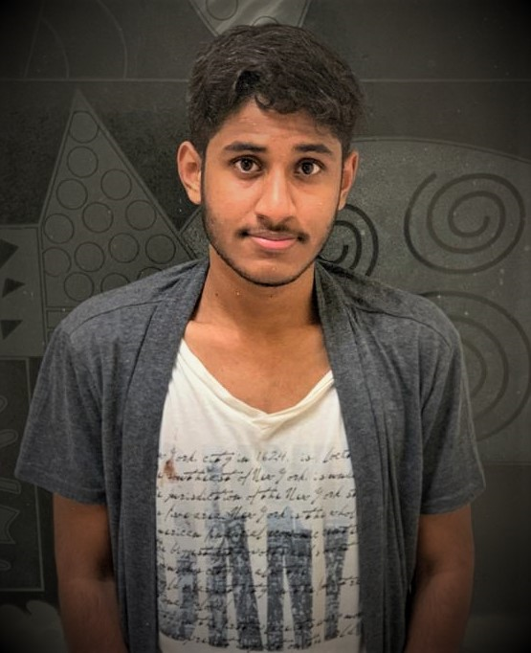
RedHat
About Me :
Name : VIJIT SAI T
College : JNTU, Hyderabad
Github : https://github.com/VijitSai

Slide 2
My learning : Week1
RedHat
ACHIEVEMENTS : Thanks to Deepak sir, he gave us an overview about a project must be handled and what it must have(i.e, SCQ) and also learnt about User Stories.
Learnt that in a project Customer satisfaction is most important.
Importance of Scrum planning.
LEARNING : Overview of Linux, Difference between Open Source and Closed Source Linux, How to install an operating system, File System Hierarchy and basic Linux commands.
Learnt about the basics of Python language and the importance of this language.

Slide 3
<Interior Design Using VR Gear>
RedHat
SCQ:
Situation - Interior designing, nowadays is considered very important. The old traditional way is to visit store. But can it be done using VR tech?
Challenge - Time saving, Virtual, Can be manipulated easily,
Questions – Multiple Design options, How can I provide alternate sources
User Stories :
As a user I expect better results at least time and cost possible
As a developer I expect customers to get attracted as it cuts down the planning time and it can be done at the customer’s home itself.

